Slide 1

ASSIGNMENT
NAME : SHOBAIKA TARIQ
COURSE : MODREN WEB AND APP
DEVELOPMENT
TOPIC : CSS PROPERTY
SUBMITTED TO : SHOBAIKA
SUBMITTED BY : MISS HAFSA NADEEM

Slide 2

CSS Z-INDEX
PROPERTY
The z-index property specifies the stack order of positioned element.

Slide 3

THE CSS Z-INDEX PROPERTY
The z-index property in CSS specifies the stacking order of overlapping elements along the imaginary z-axis (perpendicular to the screen). An element with a higher z-index value will always render in front of an element with a lower value.
Important of z-index property
The stack order defines which element should be placed in front or behind other elements.
When elements are positioned, they can overlap other elements.

Slide 4

CSS The overflow Property
The CSS overflow property controls what happens to content that is too big to fit into an area.
It specifies whether to clip the content or to add scrollbars when the content of an element is too big.

Slide 5
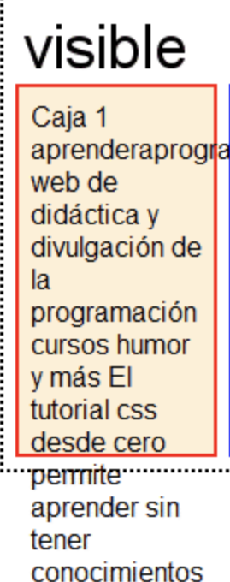
The overflow property has the following values:
Visible – Default. The overflow is not clipped. The content renders outside the element’s box.
Hidden – The overflow is clipped, and the rest of the content is hidden.
Scroll - Scrollbars are added. User must scroll to see all content.
Auto - similar to scroll, but adds scrollbars only when necessary.
CSS overflow: visible
By default, the overflow is visible, meaning that it is not clipped and it renders outside the element’s box.

Slide 6
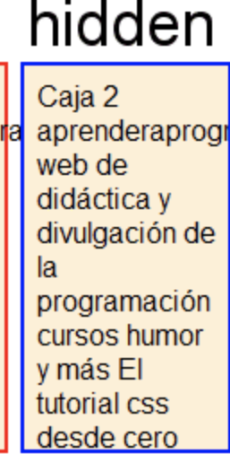
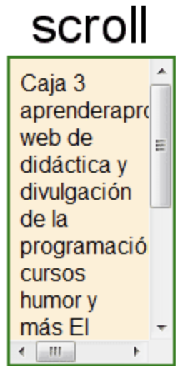
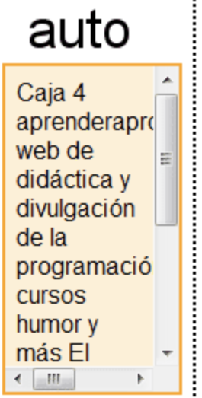
CSS overflow: hidden
With the hidden value, the overflow is clipped, and the rest of the content is hidden.
CSS overflow: Scroll
With the scroll value, horizontal and vertical scrollbars are always added. User must scroll to see all content.
CSS overflow: Auto
The auto value is similar to scroll, but it adds scrollbars only when necessary.

Slide 7
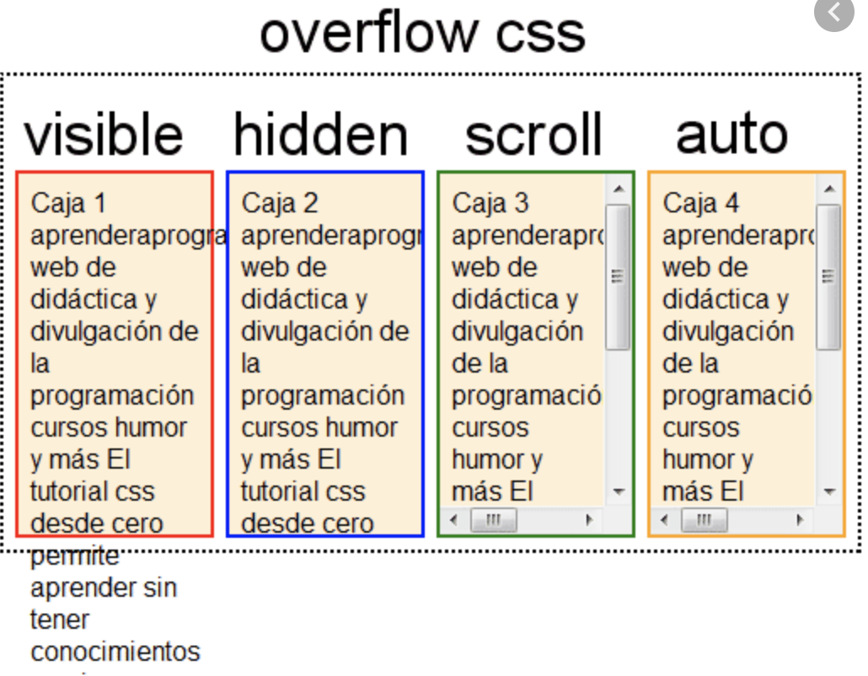
Css overflow property.

Slide 8
Thank You

